Slide 1
Inheritance
PRESENTED BY :VISHAL SINGLA

Slide 2
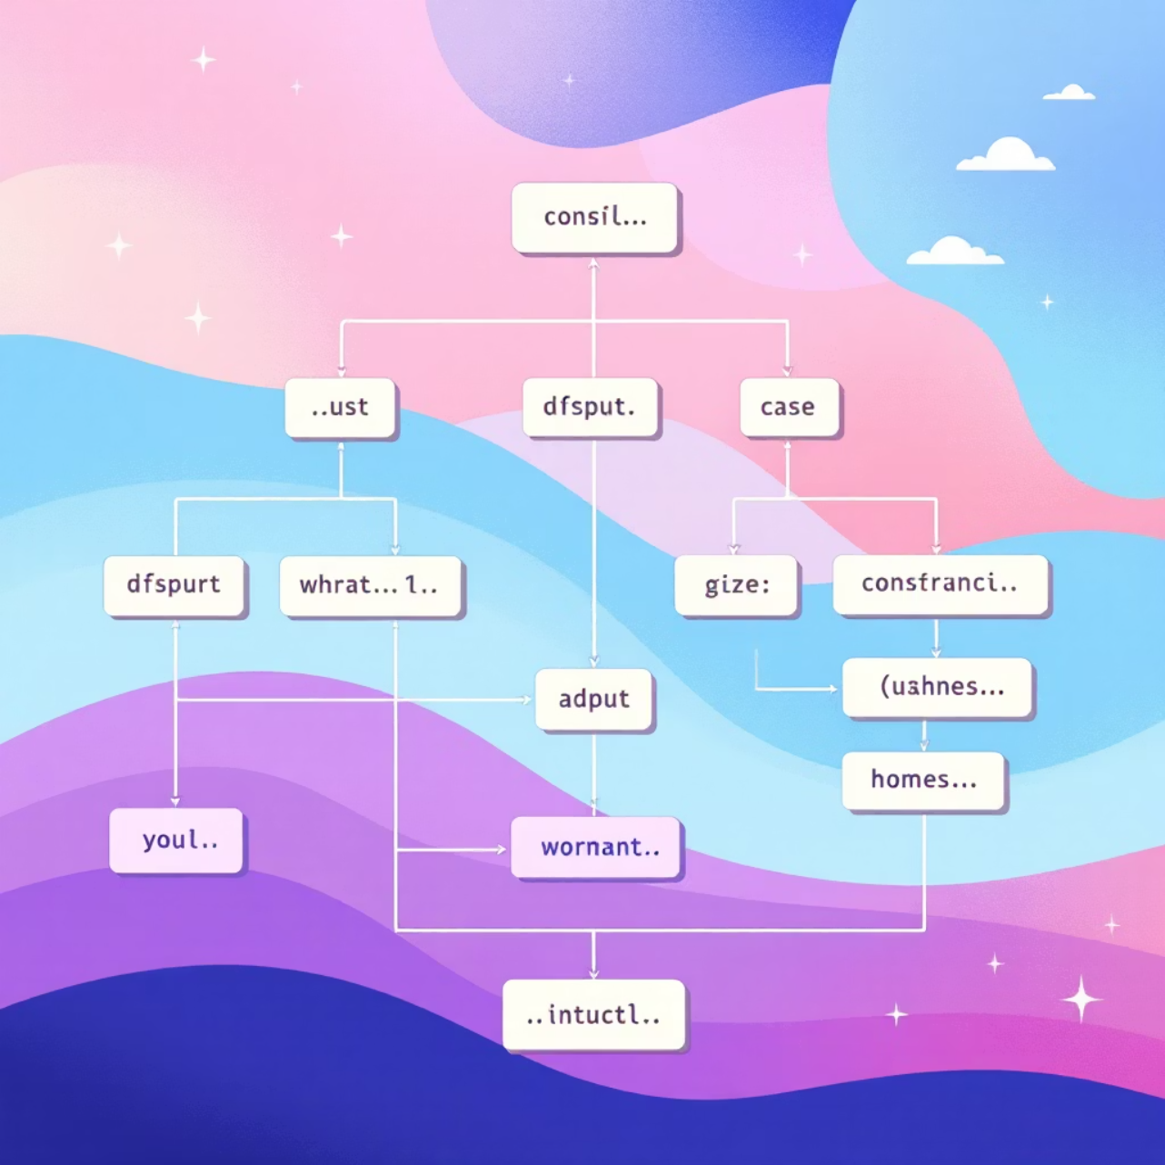
What is Inheritance in Java?
Inheritance is a fundamental object-oriented programming mechanism that enables one class to acquire the properties (fields) and behaviours (methods) of another class. This establishes an "is-a" relationship between classes, creating a natural hierarchy within your codebase.
Core Benefits
Code reusability: Write once, inherit everywhere
Method overriding: Customise inherited behaviour
Hierarchical organisation: Logical structure for complex systems
Polymorphism: Objects can take multiple forms

Slide 3

Single-Level Inheritance
Parent Class
Child Class
The base class contains common properties and methods shared across child classes.
The derived class inherits from the parent and can add its own unique features.
Java Implementation
Real-Life Analogy
class Vehicle {
void start() {
System.out.println("Vehicle starts");
}
}
class Car extends Vehicle {
void drive() {
System.out.println("Car is driving");
}
}
public class Main {
public static void main(String[] args) {
Car c = new Car();
c.start();
c.drive();
}
}
Output
Vehicle starts
Car is driving
Think of a vehicle as a general category. A car is a specific type of vehicle that inherits basic properties like wheels and engine, whilst adding car-specific features like a boot and passenger seats.

Slide 4




Multi-Level Inheritance
Multi-level inheritance creates a chain where a class inherits from a parent, which itself inherits from another parent. This forms a grandparent-parent-child relationship, allowing for progressive specialisation of classes.
Device
Smartphone
AndroidPhone
Base electronic device with power capabilities
Adds communication and display features
Implements Android-specific functionality
class Device {
void powerOn() {
System.out.println("Device powered on");
}
}
class Smartphone extends Device {
void call() {
System.out.println("Calling from smartphone");
}
} class AndroidPhone extends Smartphone {
void androidVersion() {
System.out.println("Android version 14");
}
Real-Life Example: A smartphone is a device that can make calls, and an Android phone is a smartphone with Google's ecosystem. Each level adds more specific functionality whilst retaining all previous capabilities.
public class Main {
public static void main(String[] args) {
AndroidPhone a = new AndroidPhone();
a.powerOn();
a.call();
a.androidVersion();
} output Device powered on
Calling from smartphone
Android version 14

Slide 5


Hierarchical Inheritance
In hierarchical inheritance, multiple child classes inherit from a single parent class. This structure allows different specialisations to share common functionality whilst maintaining their unique characteristics.
Employee (Parent)
Manager (Child)
Common attributes: name, ID, salary. Shared method: calculateBonus()
Adds: teamSize, organise meetings, performance reviews
Developer (Child)
Adds: programmingLanguage, writeCode, debug features

Slide 6
Hierarchical Inheritance Code
class Employee {
void work() {
System.out.println("Employee working");
}
}
class Manager extends Employee {
void manage() {
System.out.println("Manager managing team");
}
}
class Developer extends Employee {
void code() {
System.out.println("Developer writing code");
}
}
public class Main {
public static void main(String[] args) {
Manager m = new Manager();
Developer d = new Developer();
m.work();
m.manage();
d.work();
d.code();
}
}
Output Employee working
Manager managing team
Employee working
Developer writing code
This pattern is extremely common in enterprise applications, where different employee types share core attributes but have distinct responsibilities and capabilities.

Slide 7
Hybrid Inheritance via Interfaces
Java doesn't support multiple inheritance with classes due to the diamond problem. Instead, it uses interfaces to achieve hybrid inheritance, allowing a class to inherit behaviour from multiple sources safely.
Why Interfaces?
Avoid ambiguity in method resolution
Support multiple behaviour contracts
Maintain clean, predictable inheritance
Enable flexible design patterns
Workable Interface
Rechargeable Interface
Robot Class
Defines work() method for task execution
Defines recharge() method for power management
Implements both interfaces, gaining dual capabilities

Slide 8

Hybrid Inheritance Implementation
interface Workable {
void work();
}
interface Rechargeable {
void charge();
}
class Robot implements Workable, Rechargeable {
public void work() {
System.out.println("Robot doing work");
}
public void charge() {
System.out.println("Robot charging");
}
}
public class Main {
public static void main(String[] args) {
Robot r = new Robot();
r.work();
r.charge();
}
} output Robot doing work
Robot charging
Real-Life Analogy: Modern robots combine multiple capabilities—they can perform work tasks and need recharging. Using interfaces, we can mix and match behaviours without the complexity of multiple class inheritance.

Slide 9

CONCLUSION
Four Inheritance Types
Code Reusability
Better Organisation
Single-level, multi-level, hierarchical, and hybrid (via interfaces) provide comprehensive solutions for object-oriented design challenges.
Write common functionality once in parent classes, then extend and specialise in child classes—dramatically reducing code duplication.
Inheritance creates logical, maintainable hierarchies that mirror real-world relationships, making your codebase intuitive and scalable.
Inheritance is not just about code reuse—it's about creating elegant, maintainable systems that reflect the natural relationships in your problem domain.

Slide 10
END

